Slide 1




iMapInvasives Training
Date
While you’re waiting for us to start…
Please introduce yourself in the chat box:
^{Your Name}
Your name & organization
  (if applicable)
Have you used the iMap Mobile App before?
Favorite place to hike?
@nyimapinvasives
@nyimapinvasives
Notes:
Say everyone's full intro in the beginning
Transitions (pass off to “First name” and Org)

Slide 2
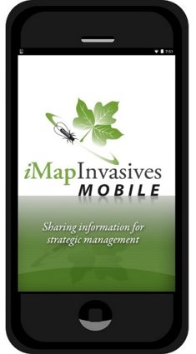
Today’s Agenda
1.
2.
3.
4.
5.
Notes:
Highlight sections (Intro, Account, Webmap, Mobile App, Questions, etc.)

Slide 3

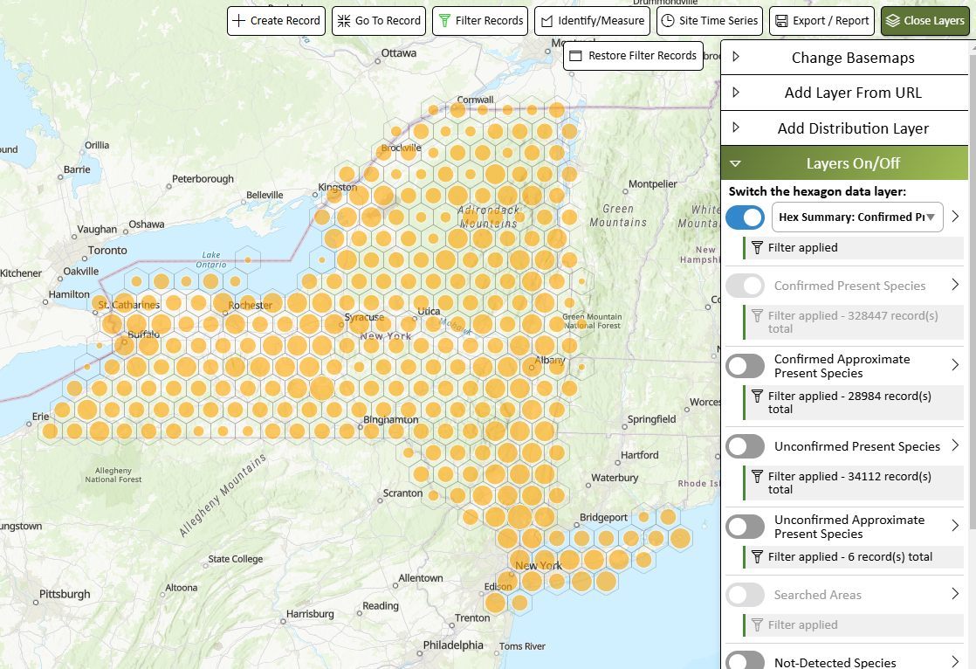
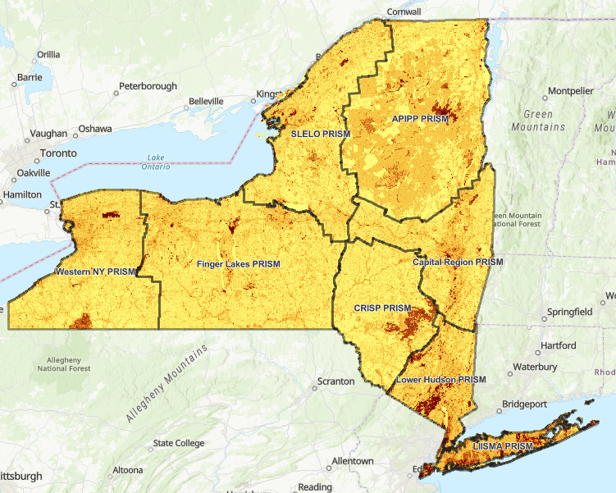

NY Natural Heritage Program
NY Natural Heritage Program
Invasive Species Database Program
Our mission is to facilitate conservation of New York's biodiversity by providing comprehensive information and scientific expertise on rare species and natural ecosystems to resource managers and other conservation partners.
Partnership between NYS DEC and SUNY ESF
Trees for Tribs
https://www.nynhp.org/treesfortribsny
Conservation Guides
https://guides.nynhp.org/
Notes:
NYNHP is the organization tasked with protecting biodiversity, and has many related programs and resources available. As one of the greatest threats to biodiversity is the establishment/spread of invasive species, iMapInvasives was chosen to be the official invasive species database for New York, and operates under NYNHP. NYNHP work with the iMapInvasives team to provide services including data hosting, data collection tools, and data analysis tools.

Slide 4
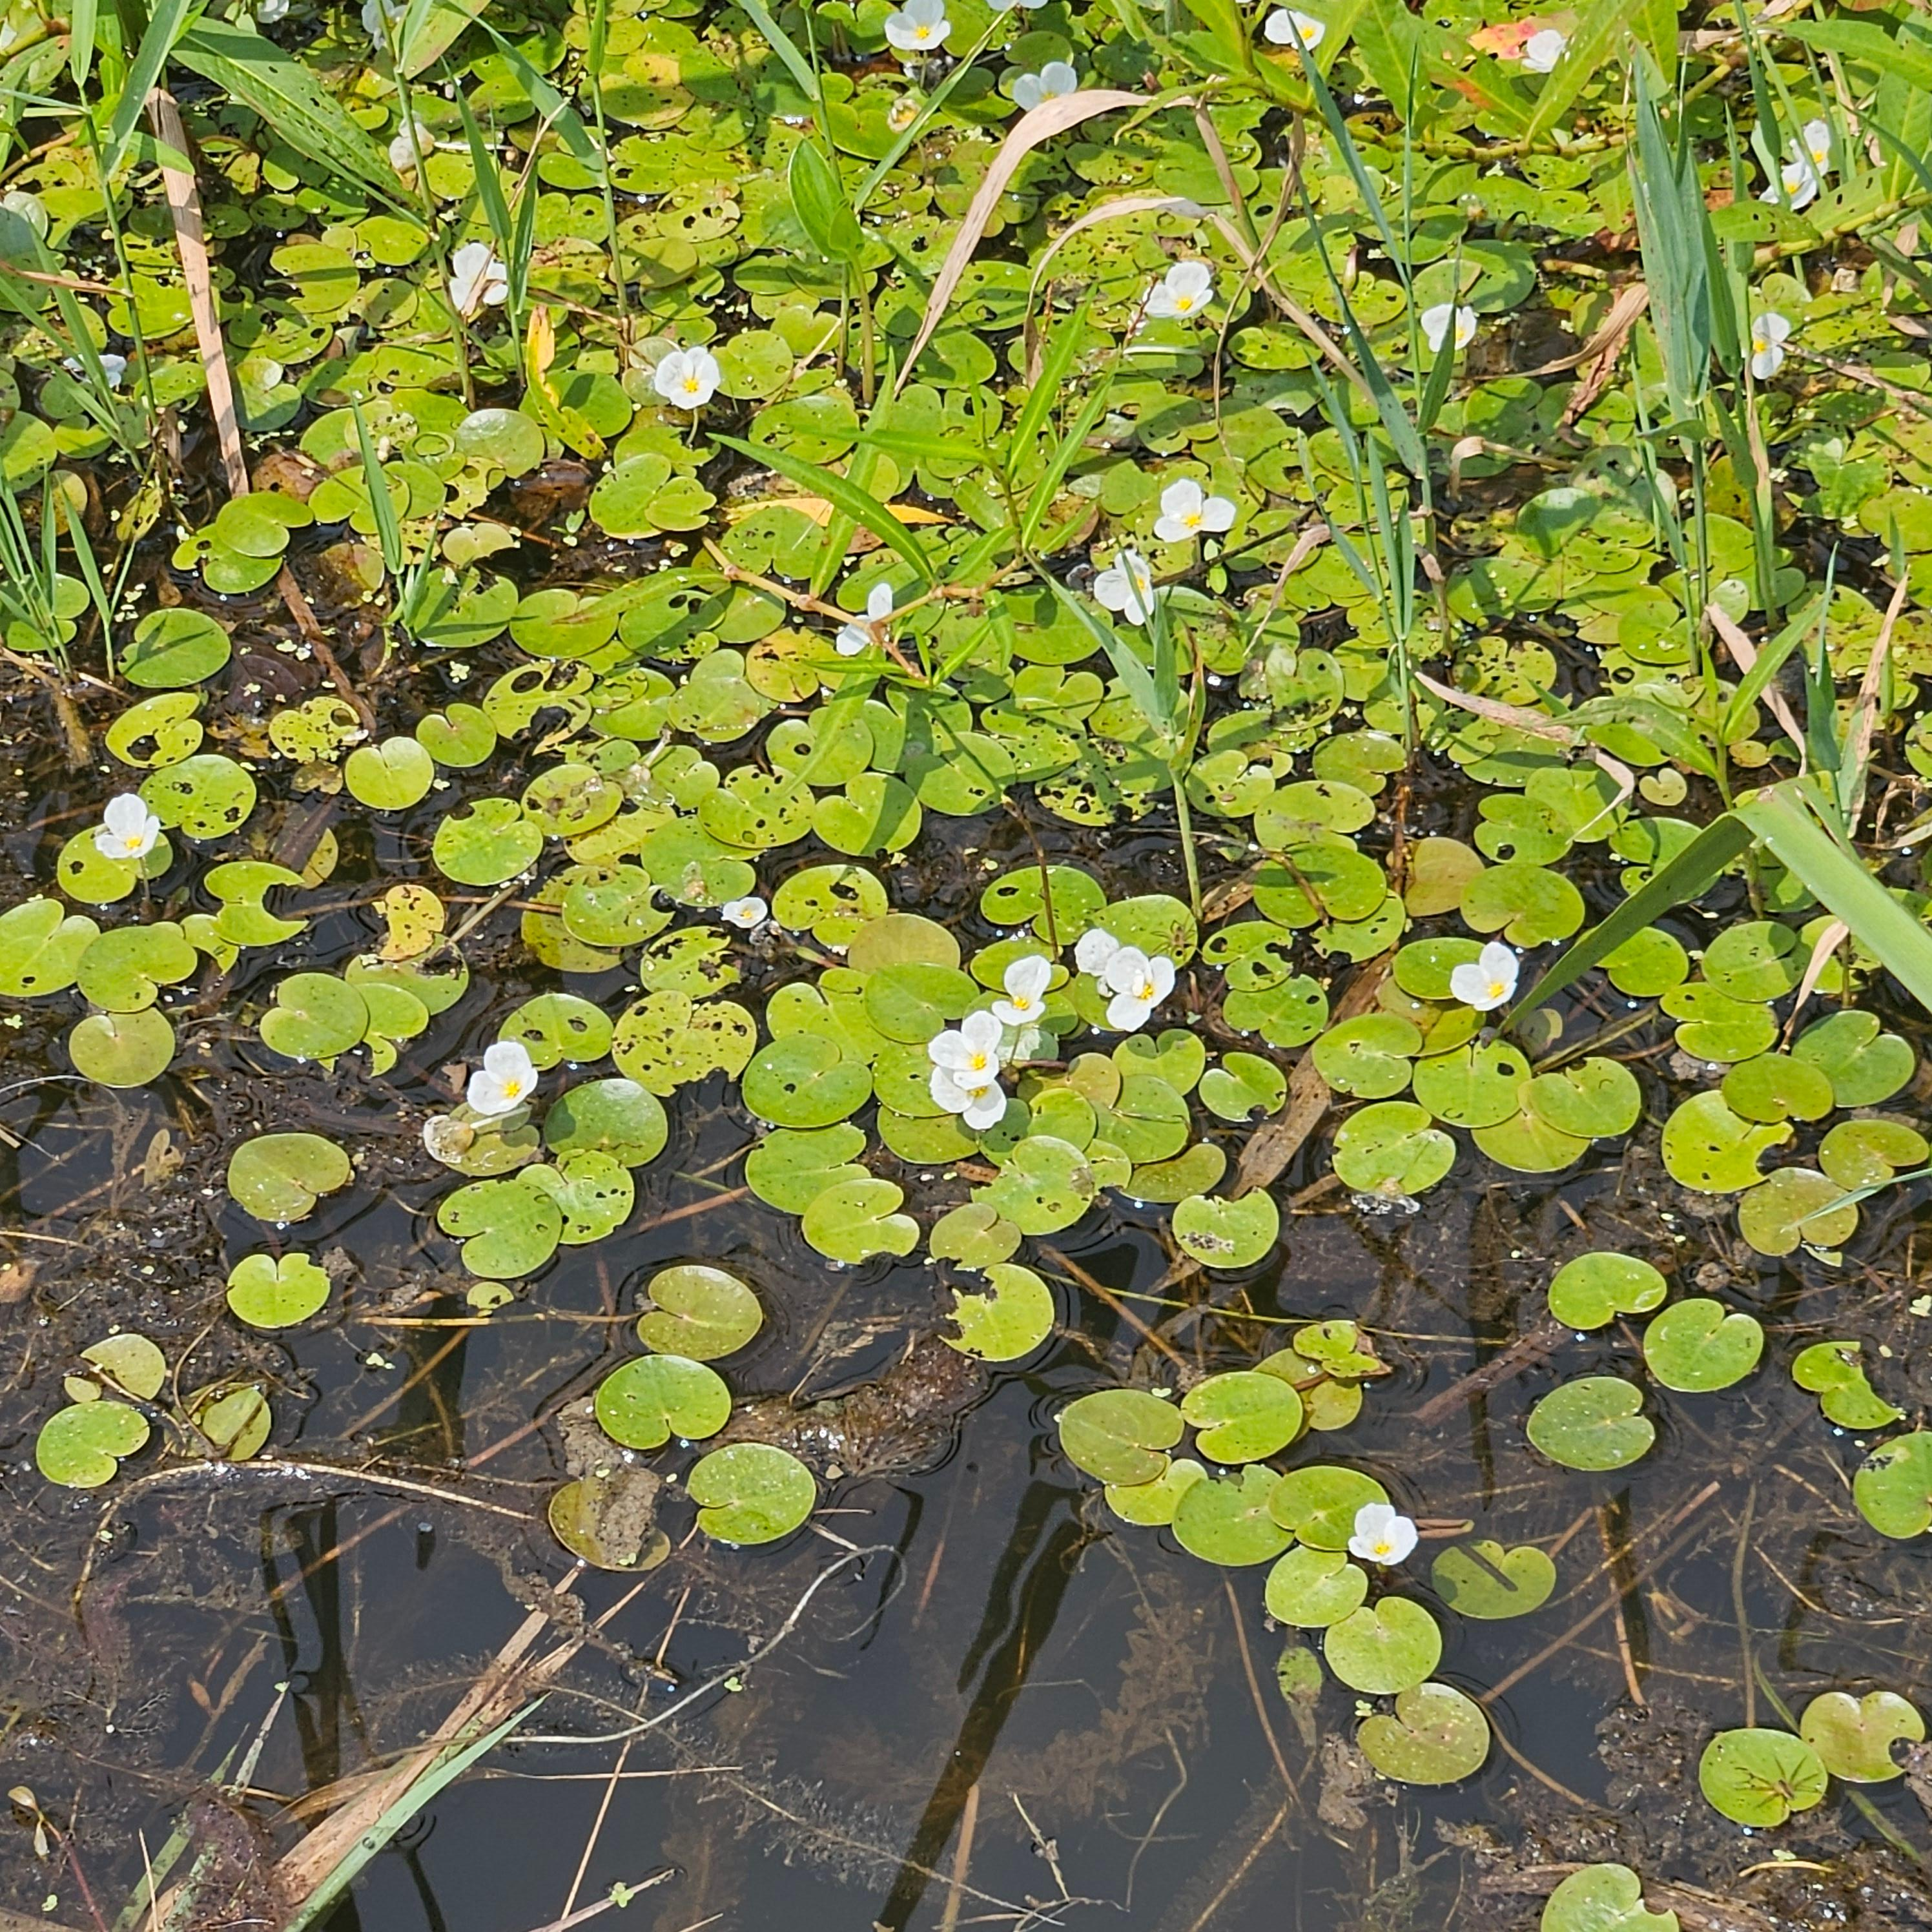
Invasive Species
Invasive species are species of plants, animals, insects, and pathogens that are:
  1. Non-native
  2. Negatively impactful
    Harm to environment, economy, and human health
European frogbit
(Hydrocharis morsus-ranae)
Notes:
Core components of what makes a species invasive. Must be non-native and harmful. Most species are harmful to all three points (economy, environment, health). Choose a relevant species for this slide and show how it can hit all three of these points.

Slide 5
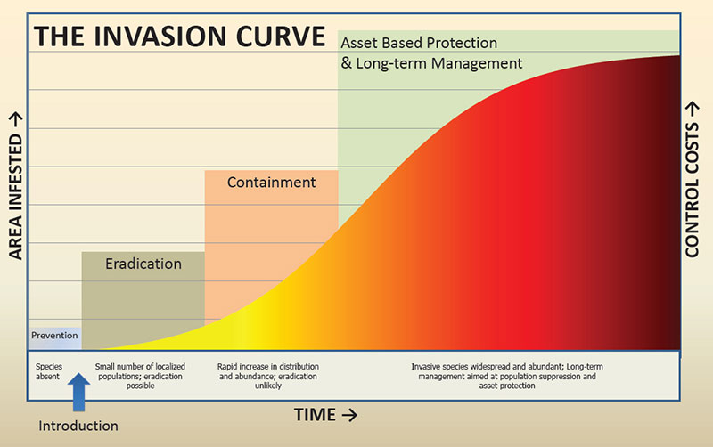
Invasive species – What do we do?
Notes:
-The more abundant a species is, the harder it is to control, and control objectives must change. It is always easiest and most cost effective to manage species lower on the curve, but any invasive can still be managed.
-Field work done by partners like Agriculture & Markets, DEC, PRISMS (Partnership for Regional Invasive Species Management). Conduct much of the early detection surveys and contribute data to our database.

Slide 6
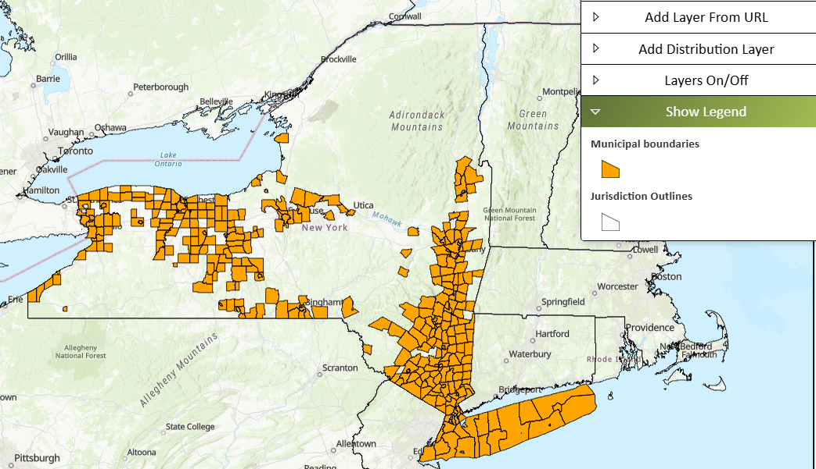
Tree-of-heaven Distribution
Not detected records
Data gap?
Notes:
Invasive example slide
Importance of mapping – knowing where species are to prioritize management for agencies and land managers.

Slide 7
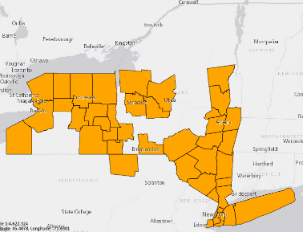


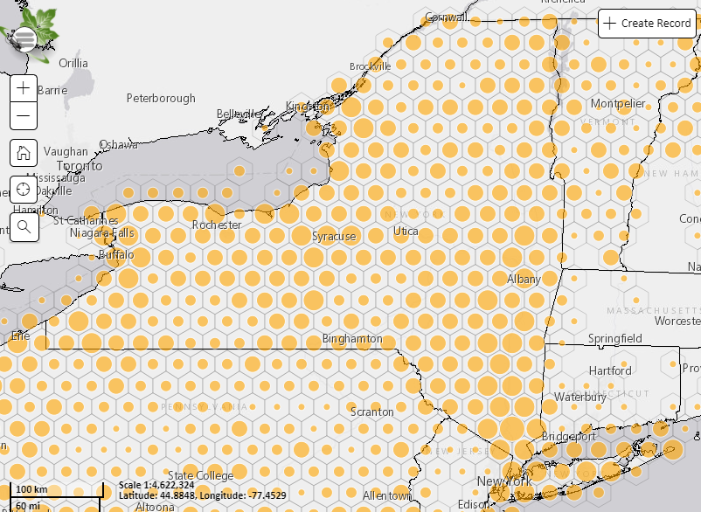
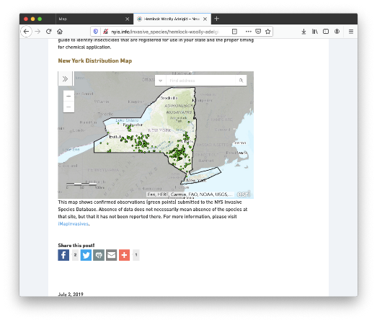
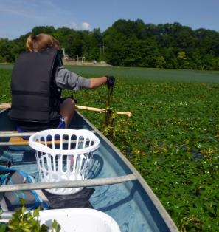
iMapInvasives
Centralized invasive species database to support PRISMs, state agencies and other partners working on invasive species issues.
4
Species Distributions and Reports
Early Detection Alerts
Tracking Control Efforts and Results
Web Map Services
Notes:
iMapInvasives is the official invasive species database for New York State, which allows for storage of invasive species data for presence, not-detected, treatment/management, and more.
-The map viewer lets users see where data is, and lets users generate distribution maps and automatic reports.
-Users can set up email alerts to get info on species/areas of interest.
-Web map services allow live views of the database to be embedded in other web pages.
-Contributing data over the course of many seasons/years allows tracking and analysis of results

Slide 8
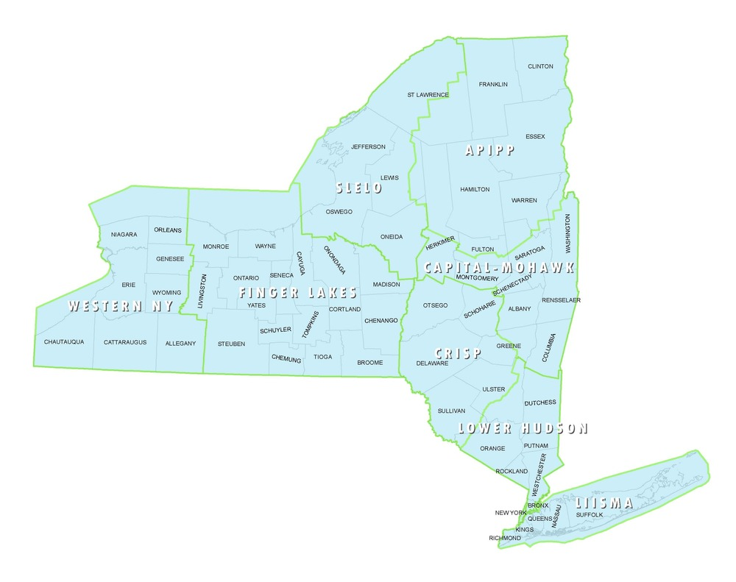
PRISM
Partnership for Regional Invasive Species Management
Management
Prevention programs
Surveillance and mapping
Habitat restoration
Early Detection & Rapid Response
Coordinate volunteer/ community science efforts
More!
APIPP
Adirondack Park Invasive Plant Program
SLELO
Saint Lawrence and Eastern Lake Ontario
Capital Region
Finger Lakes
Western NY
Catskill Regional Invasive Species Partnership
CRISP
Lower Hudson
LIISMA
Long Island Invasive Species Management Area
MO
Notes:
PRISMS – the ‘boots on the ground’
Listserv – each PRISM has one that gives info related to trainings, volunteer opportunities, conferences, jobs, etc.

Slide 9






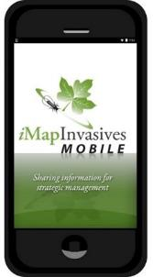



Data sources
Uploads of existing data from partner organizations
  Local, State, and Federal Agencies
  Land/ Water Managers
  Researchers
  Museum Data
Data entered by community scientists & professionals
Species ID confirmed by experts
And you!
NYISRI
Notes:
-iMap utilized by many different entities: state agencies, NGOs, land trusts, friends groups, academic institutions, and YOU
-all data entered into iMap is unconfirmed until reviewed by an expert.

Slide 10


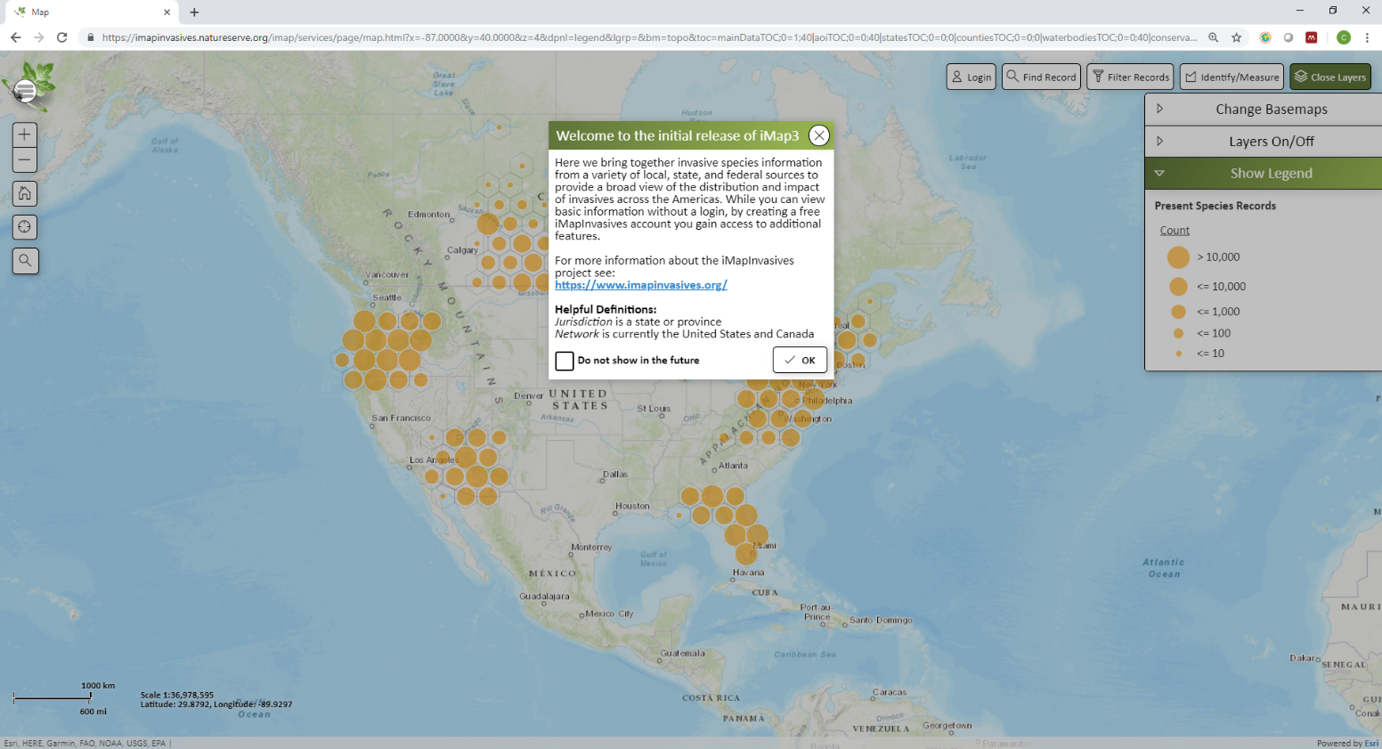

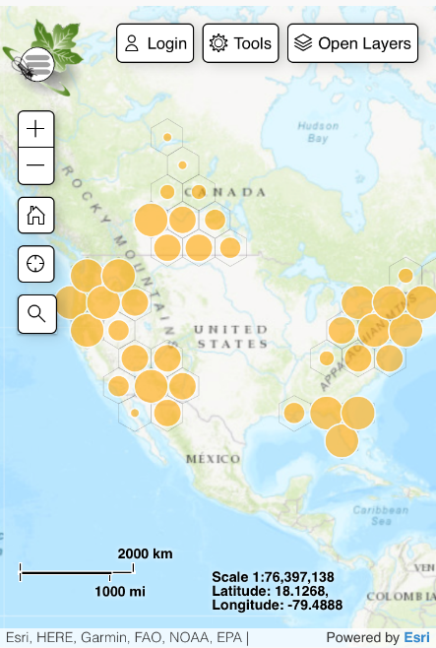

iMap Data Inputs and Outputs
Email Alerts
Web Map Services
iMap
Platform
Mobile App
Web Interface
Point records only
Presence, not-detected
Does not require connectivity,
once configured
Point, line, and polygon records
Presence, not-detected, treatments
Requires connectivity
Notes:
-The web interface is a two way street: you can submit data to it directly, and get data out of it. Works on desktop, phone web browser, and on most browsers.
-The mobile app is a one way street: you can submit data to the database, but you cannot access the database. This also allows it to function without internet/cell service.
-Email alerts and WMS are a one way street out of the database: You receive data, but cant interact with the database directly using these.

Slide 11
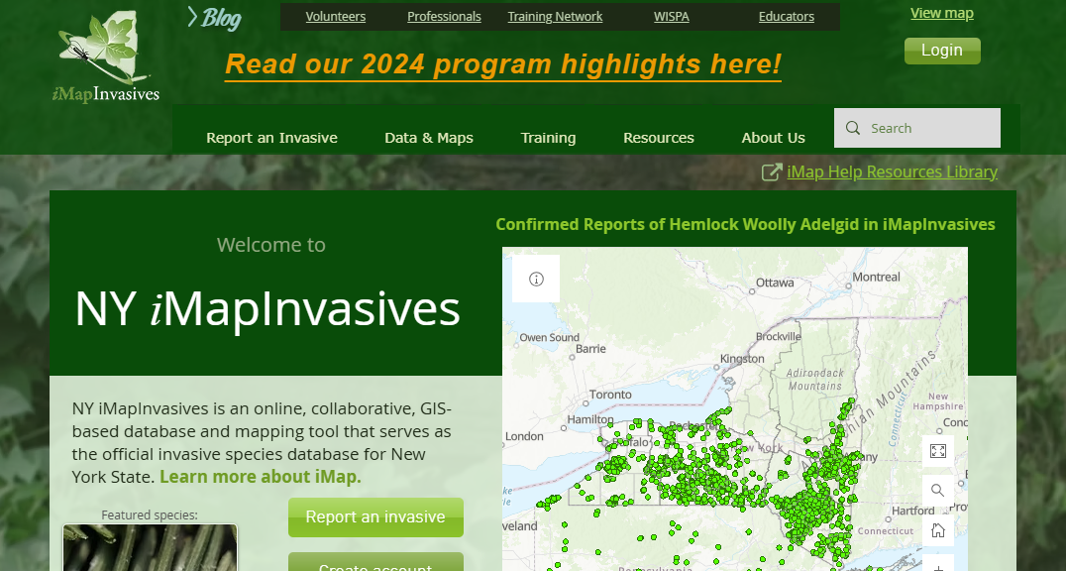
Account setup
nyimapinvasives.org
Please follow along
Notes:
Start of the next ‘agenda item’ – creating an account and accessing the database

Slide 12
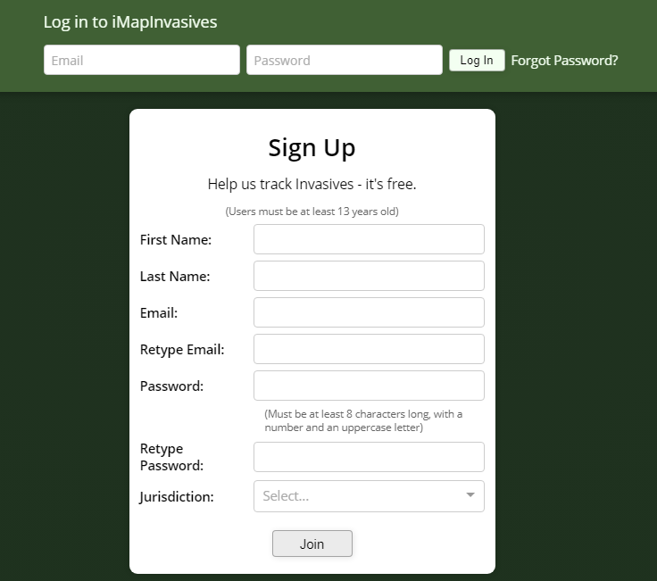


Create Account/Login
imapinvasives.natureserve.org
Login (if you have account)
*If you haven’t signed in for a while, click here to reset account
Create Account
Check email for link (“click here”), click open the User Agreement.
Read User Agreement and accept
New York
Notes:
-Briefly read user agreement. Contains information on how your data is used once in the database, and what you are allowed to do with the data. Reminder that the iMapInvasives database is public.
-Once you accept the user agreement, your profile is considered ‘active.’ You can then use the top ‘log in’ bar to access your account
-The user agreement link is good for 7 days. If you do not accept the Terms within that time period, the link expires and you will need to contact iMapInvasives to reset the link.

Slide 13
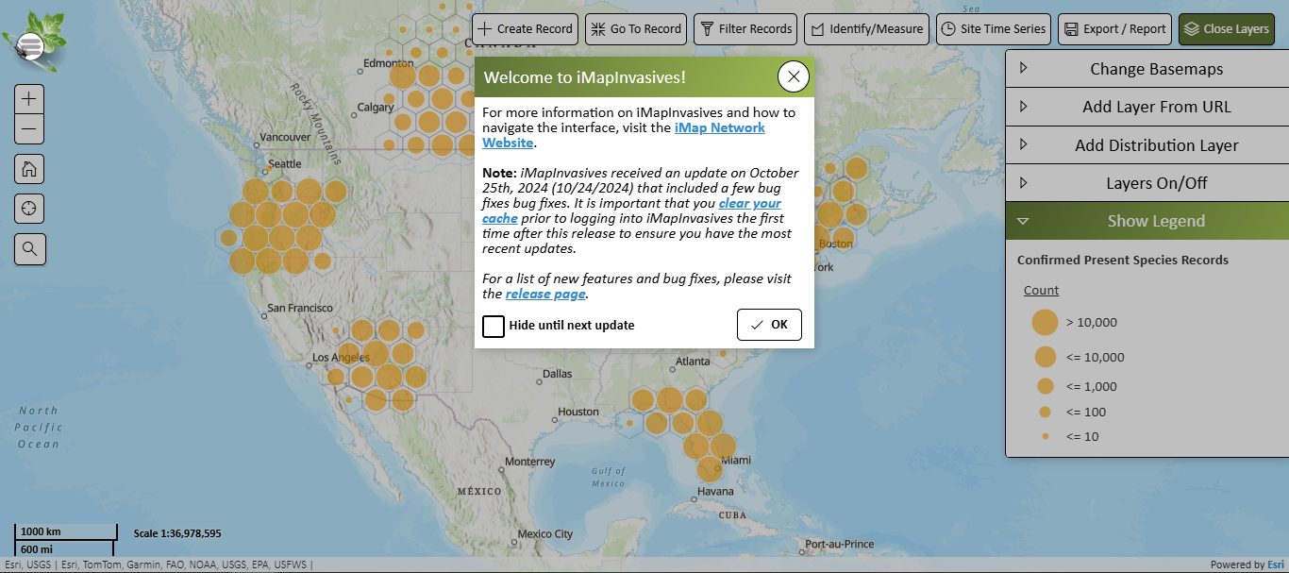
Log in
Notes:
Once you log in, you are met with the database map. The popup window lets you know the latest updates. If you frequently use iMap, it is good to clear your browser cache after an update to ensure it functions properly.

Slide 14
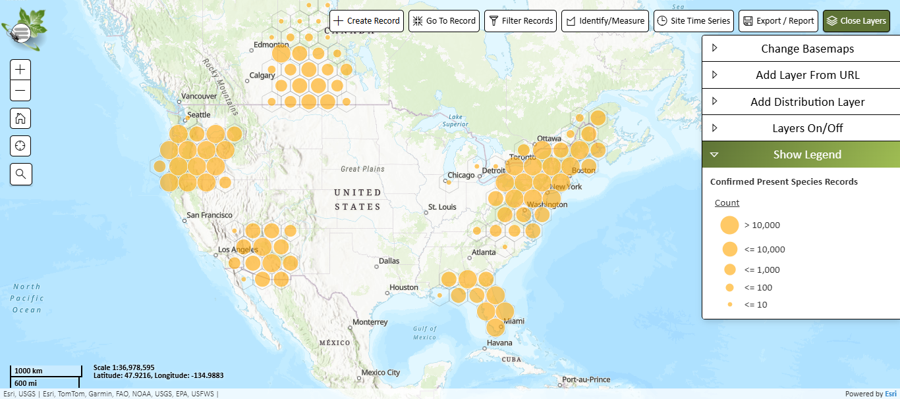
iMapInvasives Online
Main Menu
Main Menu
Action Tools
Navigation
Geographic Layers
Notes:
Main menu – account settings, projects/organizations, email alerts
Navigation – zoom, your location, address lookup
Action tools – Make record (points, lines, polygons for presence, not detected, treatments). Go to a record using ID#, filter tool, measure distance or identify records in a drawn polygon, show timelapse of records coming, export data or make auto-generated reports
Geographic layers – change the basemap, add external data temporarily, show distribution based on a chosen geographic distinction for your filtered species, toggle data layers.

Slide 15
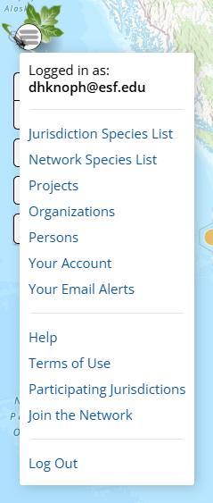
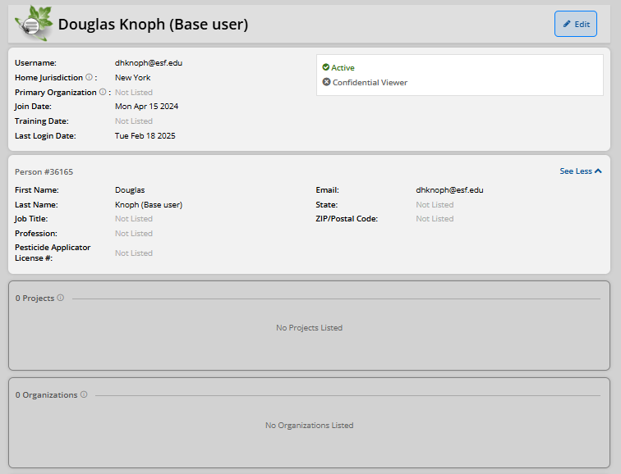
Your Account
Your info
Orgs and Projects
Notes:
-Account can follow you throughout your career – change username to swap the email associated with the account.
-If using certain advanced iMap field data collection tools, you will need the Person # from this page. This is not needed for the mobile app though.

Slide 16
Organizations and Projects
Organizations
If you are doing invasive species surveys/management as a part of your job duties, join that organization.
Community scientists and volunteers do not need organizations
Projects
Great way to group data for a project/grant
Great for people volunteering for organization
Ex) Mapping efforts across organizations, PRISM-coordinated volunteer efforts
Notes:
Organizations:
-Recommended if you are staff
-Not necessary (unaffiliated volunteers, etc.)
-Membership in an organization is necessary for collecting and viewing treatment data. If you are doing treatment but are not a professional, there is a placeholder org called ‘No Organization Affiliation (NY)’
Individual vs. organizational project
-If not in an org, you can have individual projects to sort your own data
-If in an org, you can associate project to an org, and invite other people (org members, volunteers, etc.) to submit data to that project.

Slide 17
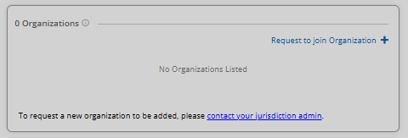
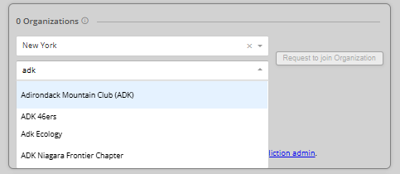

Joining Your Organization
Click “Edit” on the top right.
Scroll down to the organizations box and click “Request to Join …”
Type your organization into the search bar and click your organization in the drop-down.
Click “Request to join …”
Press on the top right corner
Now, this organization will appear on your account. You will be listed as pending until the admin for your organization changes you to Member
Notes:
Go through quickly, but we do have help docs

Slide 18
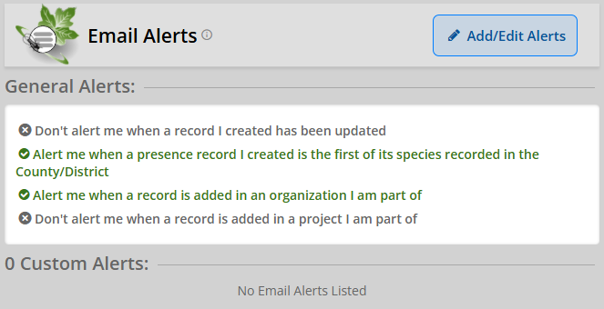
Account Setup - Email Alerts
Important Feature set up so that state officials are alerted to new observations
Everyone can use these alerts to stay informed on species/geographic areas they are interested
Example: European Frogbit in Capital Region PRISM
General alerts you can opt in or out of
Custom Alerts
Notes:
Help doc exists for this process

Slide 19
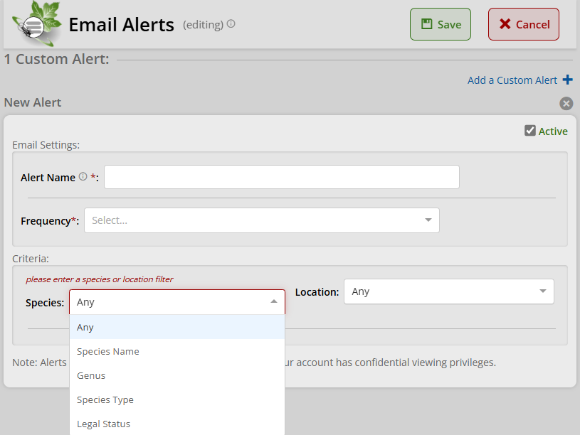
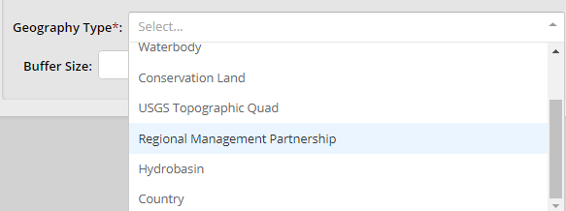

Custom Email Alerts
This will be the subject on alerts
How often - digests
Enter Species Name
Plant/Animal/Microorganism
Aquatic/Terrestrial/Marine
Notes:
- Process of setting up an email alert

Slide 20
Database → Mobile app
Email Alerts
Web Map Services
iMap
Platform
Mobile App
Web Interface
Point records only
Presence, not-detected
Does not require connectivity,
once configured
Point, line, and polygon records
Presence, not-detected, treatments
Requires connectivity
Notes:
Next agenda item – using the mobile app

Slide 21


Mobile App
Download app from Google Play or iOS App Store (search for “imapinvasives”)
Please follow along
Questions? Chatbox
Notes:
-How to download the app.
-Depending on the kind of training you’re holding, and the technical skill level of your group, this may good information to send people before the training.
-You can do the ‘follow along’ if you have the app downloaded; even if you do not yet have an account set up, youre still able to collect records (just not submit them yet).

Slide 22




Mobile App
Setup Account and App
Record invasive species
Upload records to iMap
Connectivity required
Connectivity NOT required
Connectivity required
Notes:
‘The connectivity sandwich’
-You need wifi or cell service to do the initial app download and account login/setup
-You do not need any service or wifi to collect data out in the field. Records will be saved to your device temporarily
-You will need wifi or cell service again to submit your records to the database

Slide 23
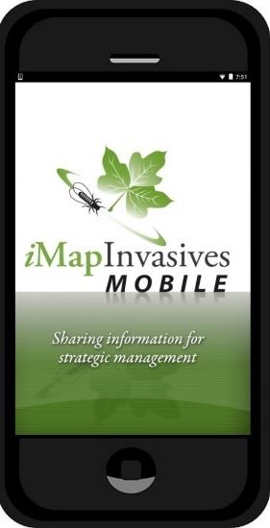
Live Demo
1. Set Preferences
“Retrieve iMap Lists”
Custom Species List
Set Default Project
2. Record an observation of “Fake Species”
3. Upload observations
Notes:
Steps of the live demo – encourage attendees to follow along

Slide 24
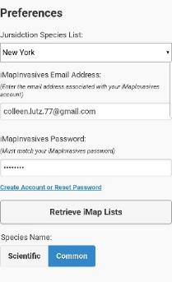
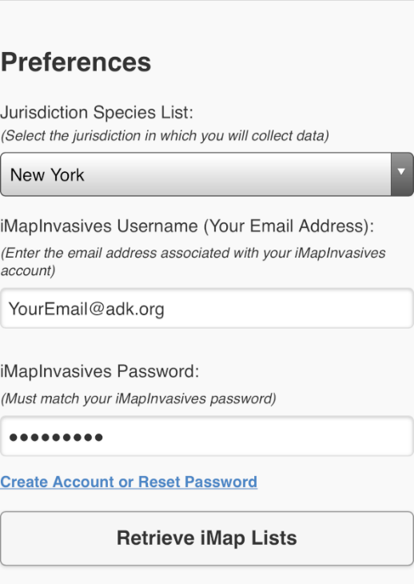
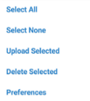
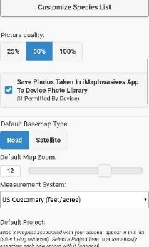
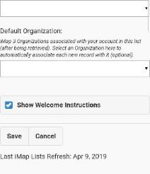
Mobile App Setup
Notes:
If it’s your first time logging in, it bring you straight to preferences (shown on left of slide)
If it’s not your first time, go to the menu icon on top lest and select preferences.

Slide 25
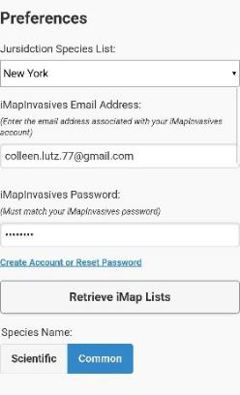
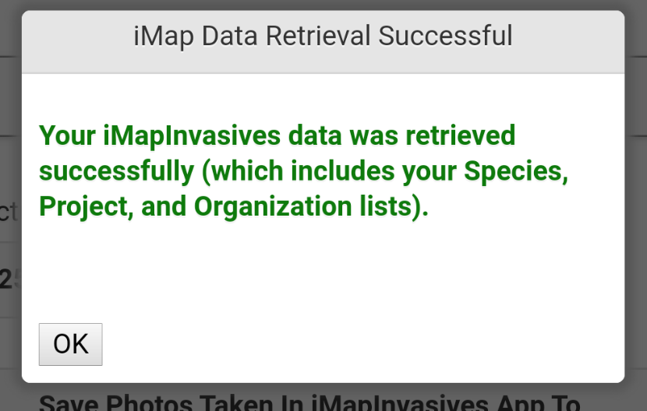



Mobile App Setup
Username and password Must match iMap account online
Sometimes iPhone’s add space after password
Notes:
Type in email and password (same as online account) and hit Retrieve iMap Lists
Green successful method = good
Error message – username password don’t match online, try again (careful with typos, make sure space isn’t added)
Tip – double check that you are able to sign in online (you may need to reset password)

Slide 26

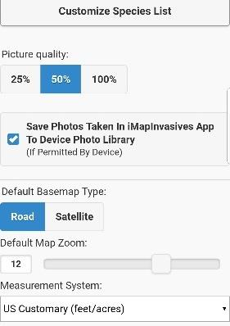

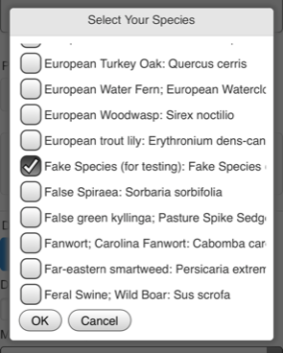
Preferences - optional
View lists as scientific or common names
Optional – Make a short list of species you know, are interested in, and expect to survey for in your area
A Fake Species (for testing)
European Fogbit
Jumping Worm
Tree-of-heaven
Water chestnut
Defaults are typically fine
Notes:
List species you are covering in alphabetical order so you can scroll through and add them – make sure to add Fake species! We will use it for testing

Slide 27


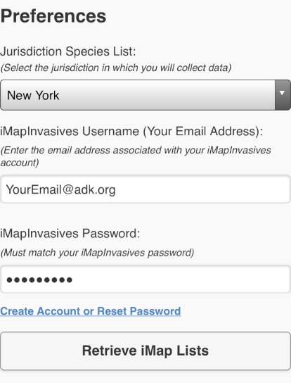
Mobile App - preferences
If your org/project is not appearing
1. Join Organization or Project Online
2. Select Retrieve iMap Lists
3. Set to Default
My Default Project
My Default Organization
Save!
Notes:
Set your default org and project if you have any.
Note: If your organizations and projects are not showing up as options here, it’s because you weren’t part of the organization or project when you first set up the app. Click “Retrieve iMap Lists” to refresh, and any organizations you are currently a member of will show up.

Slide 28



Mobile App
Setup Account and App
Record invasive species
Upload records to iMap
Connectivity required
Connectivity NOT required
Connectivity required
Notes:
The good part of the sandwich – the filling

Slide 29
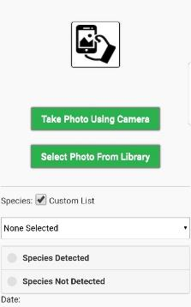
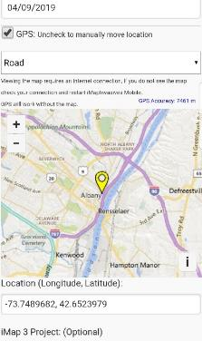
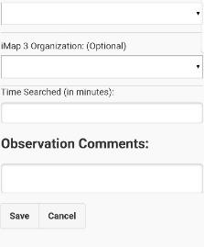
Add Observation
+Add Observation
Please follow along
Notes:
Again – anyone can follow along if they have the app downloaded, even if they do not yet have their account set up

Slide 30
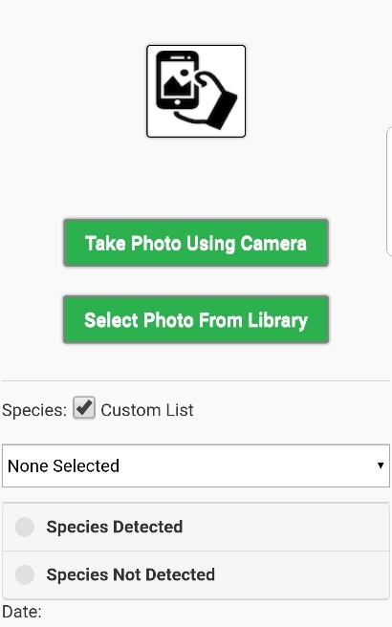

Add Observation
Take photo with camera
Enable your custom species list
Select Species – A Fake Species (for testing)
Select Detected or Not Detected
If you select photo from library, the iMap app will pull the location and date metadata from the photo (assuming your camera is set to capture metadata, and the appropriate permissions are available
Notes:
We are having everyone follow along and enter a fake species record. People can also submit fake species records whenever they want to make sure their app is set up properly.

Slide 31
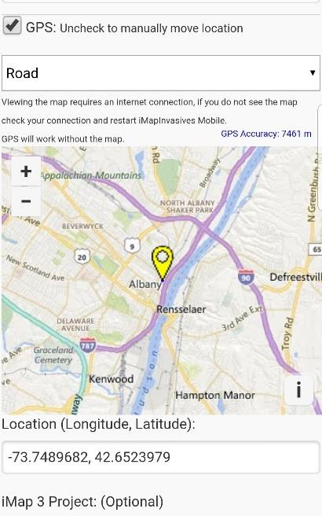
Add Observation
Note: Map will be blank when out of connectivity
Your location
Your coordinates: If 0,0 is displaying in the Location box, make sure your GPS is enabled on your device
Notes:
Note: map may be background when in remote areas (like in Adirondacks)
You are still fine as long as Lat/lon is showing up as a number

Slide 32

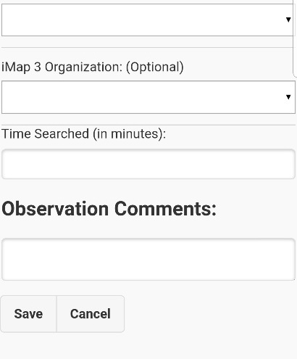
Add Observation
My Default Project
Change or select
My Default Organization
Enter the approximate time you were searching for invasive species (optional)
Add any comments that may enhance the quality of your observation report
Don’t forget to save your changes!
Notes:
-Note that you can change or select org + project here, but we recommend setting defaults in preferences so they show up here without you having to worry about it.
-Saving is the most important part! This stores the record on your device until you are back in service/wifi

Slide 33

Mobile App
Setup Account and App
Record invasive species
Upload records to iMap
Connectivity required
Connectivity NOT required
Connectivity required
Notes:
Step 3 – uploading your collected records

Slide 34
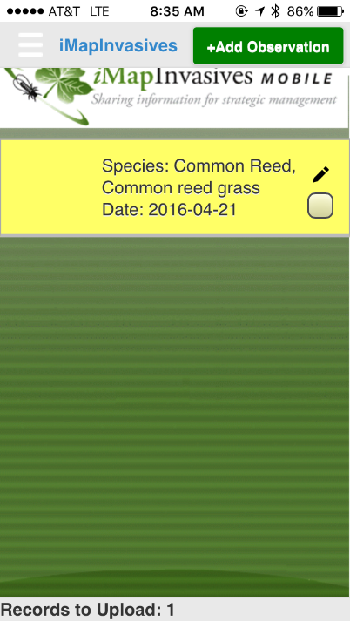
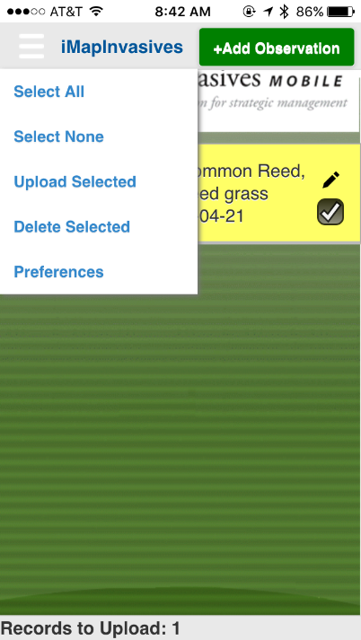
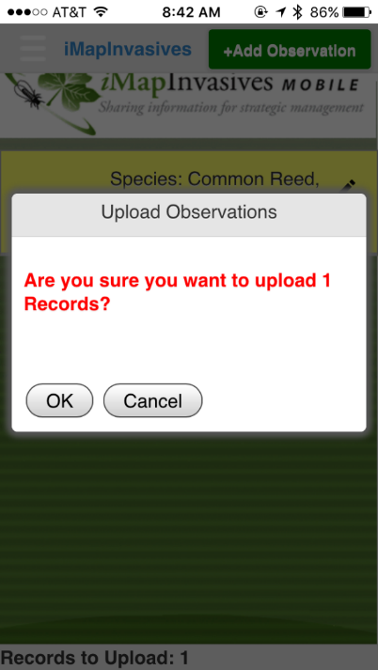
Uploading records
Notes:
You can edit the record with the pencil icon, or check the box if it’s ready

Slide 35

Uploading records
Questions about Mobile App?
Type into the chatbox!
Record is on your device, NOT in the online database
Record has left phone,
Is in online database
Notes:
Emphasis

Slide 36
Mobile App
1. Set Preferences
“Retrieve iMap Lists”
Custom Species List
Set Default Project
2. Record an observation of “Fake Species”
3. Upload observations
Notes:
Mobile app training complete

Slide 37
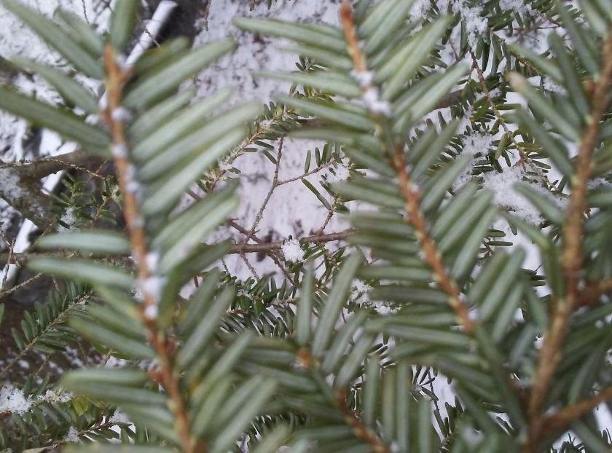
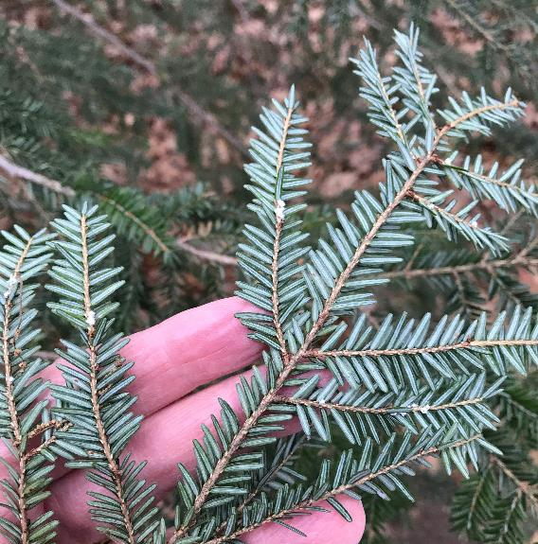
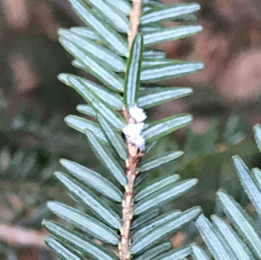
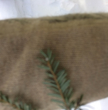
Good Photos are Essential!
Need to focused and close-up enough
Hand or sheet of paper behind plant provides scale and helps with focus
Notes:
-Most important part: photos must be good enough that an expert can look at the photo and say “yes, this record is correct.”
-All records from mobile app are manually reviewed by experts
Fuzzy photos – hard to tell if its HWA for sure
Clear photo – easier to tell its HWA

Slide 38





Mobile App vs. Online
Mobile App
Online Web Application
Questions on Account set up online?
Type into the chatbox!
Collecting Simple Data: Mobile app
Download to your mobile phone or tablet,
Presence & Not-Detected
no connectivity needed to collect data
The Whole Database: On the web
Browser-based interface for your desktop or mobile phone, with connectivity
Presence & Not-Detected & Treatment
Queries/Reports/email alerts
Google Chrome or Mozilla Firefox
Notes:
Moving back to the web application to emphasize a few points, point out features

Slide 39
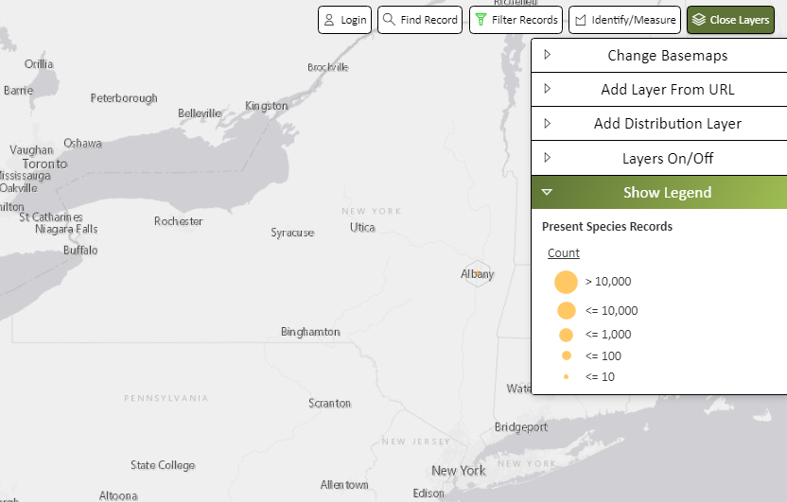



Using iMapInvasives
Use Filter tool to filter on species or observer
Layers On/Off
Export/Report Tool Species list by geography
Distribution Layers
Notes:
-Brief overview of stuff you can do with data on iMap – not required!!!!
-Good for professionals, or if you want to teach volunteers how they can see their own data/project data

Slide 40



Help Resources
NYimapinvasives.org
imapinvasives.org/help
Recordings of past webinars
Online help docs and tutorials
Educator resources
NY iMap helpdesk
imapinvasives@dec.ny.gov
Notes:
NY website – all our helpdocs available at the circled link. This link appears on the top of most pages. You can also find this link under ‘Training > Help Resources Library’
Main iMap website – has documents not specific to NY for some general things like how to utilize organizations and projects, account permissions, etc. Most of these resources also appear on the NY helpdoc library

Slide 41

Thank you! Questions?
Enter questions into the chat box or unmute your microphones
We encourage you to go out and map invasive species!
@nyimapinvasives
Email: imapinvasives@dec.ny.gov
Notes:
People can email iMap with tech support/account issues.
Q/A

Slide 42

Advanced Mobile Tools
Notes:
-Geared more towards professionals: other data collection tools that iMapInvasives provides
-Some readily available, some require access to be requested, or require you to have an ArcGIS Online account
-Recorded trainings exist for some, others may require a more direct training from iMap staff

